Slide 1

Note: The data and information in this document is reflective of a hypothetical situation and client. This document is to be used for KPMG Virtual Internship purposes only.
Sprocket Central Pty Ltd
Data analytics approach
[KPMG Analytics Team] - Neeha Hammad, [Junior Consultant]

Slide 2
Note: The data and information in this document is reflective of a hypothetical situation and client. This document is to be used for KPMG Virtual Internship purposes only.
Agenda
Introduction
Data Exploration
Model Development
Interpretation

Slide 3
Note: The data and information in this document is reflective of a hypothetical situation and client. This document is to be used for KPMG Virtual Internship purposes only.
Introduction
Key Analysis Points After Cleaning Data
Age Group Distribution
Gender Distribution
Industry Category Distribution
Wealth Segment Distribution
Location (States) Distribution

Slide 4
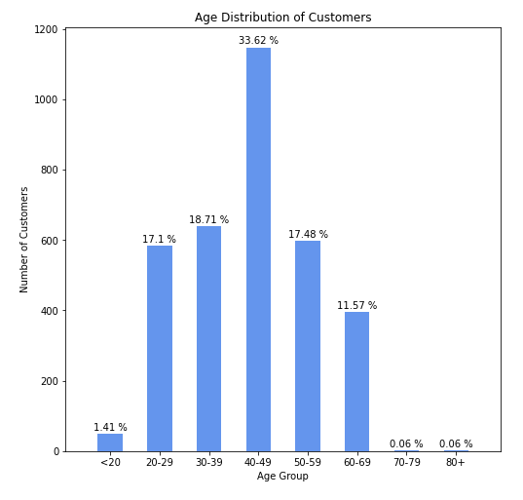
Note: The data and information in this document is reflective of a hypothetical situation and client. This document is to be used for KPMG Virtual Internship purposes only.
Data Exploration
Age Distribution of Customers
A large percentage of our customers falls in the 40-49 age bracket.
Average customer age is 42.
Place any supporting images, graphs, data or extra text here.

Slide 5
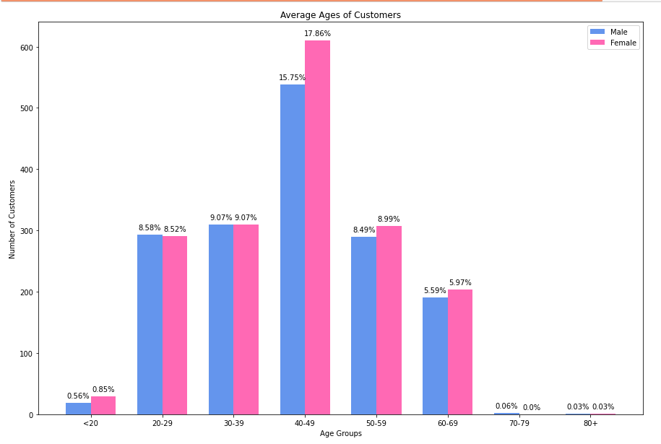
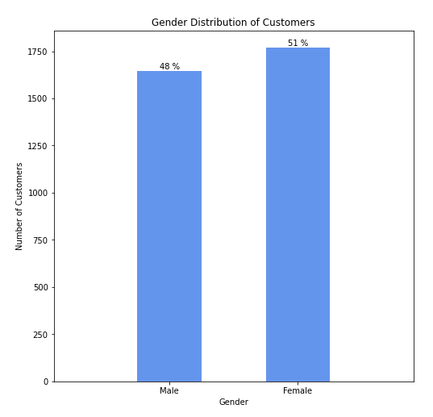
Note: The data and information in this document is reflective of a hypothetical situation and client. This document is to be used for KPMG Virtual Internship purposes only.
Data Exploration
Gender & Age Distribution of Customers
Although both genders have a similar distribution, female customers are more.

Slide 6
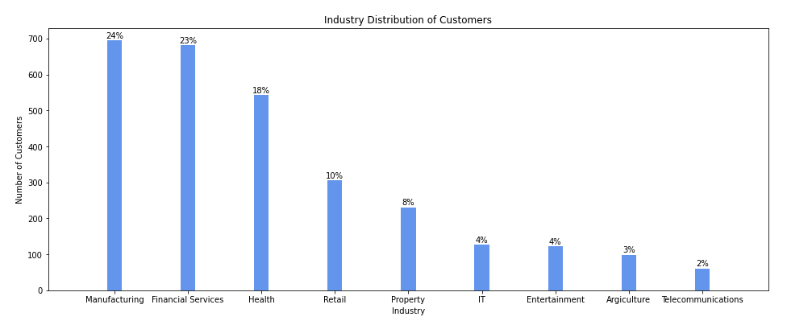
Note: The data and information in this document is reflective of a hypothetical situation and client. This document is to be used for KPMG Virtual Internship purposes only.
Data Exploration
Industry Distribution of Customers
Most customers come from the Manufacturing and Financial Services industries.

Slide 7
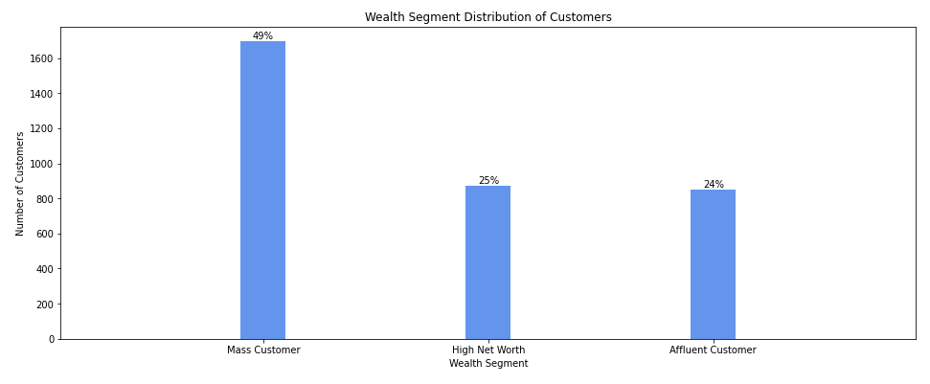
Note: The data and information in this document is reflective of a hypothetical situation and client. This document is to be used for KPMG Virtual Internship purposes only.
Data Exploration
Wealth Segments of Customers
Most customers are Mass Customers.

Slide 8
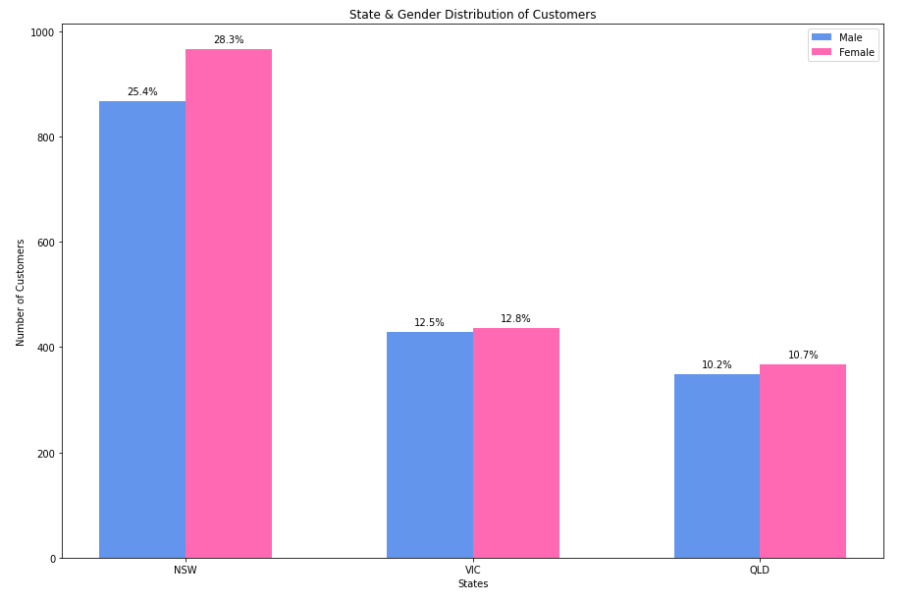
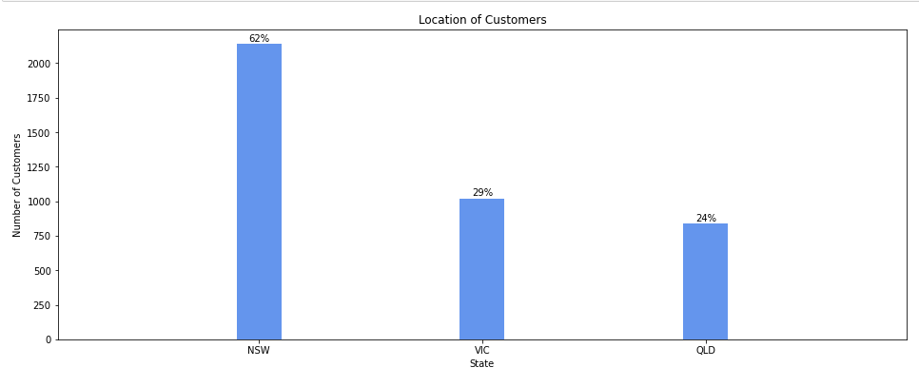
Note: The data and information in this document is reflective of a hypothetical situation and client. This document is to be used for KPMG Virtual Internship purposes only.
Data Exploration
Location of Customers
Most customers are based in New South Wales.

Slide 9
Note: The data and information in this document is reflective of a hypothetical situation and client. This document is to be used for KPMG Virtual Internship purposes only.
Model Development
What we had to fix to achieve our results:
Remove entries with null values
Calculate ages using the date of birth column
Remove contradiction in gender values
Remove contradiction in state values
Join CustomerDemographics and CustomerAddresses tables
[Juputer Notebook attached]

Slide 10
Note: The data and information in this document is reflective of a hypothetical situation and client. This document is to be used for KPMG Virtual Internship purposes only.
Interpretation
What to focus our marketing/business strategies on:
Marketing strategies should be designed keeping in mind different age brackets from ages 20 - 70.
Higher focus should be on individuals that are 40-50 years old.
Higher focus on females.
Higher focus on Manufacturing and Financial Services industries from the mass customer segment.
Higher focus on New South Wales.

Slide 11
Note: The data and information in this document is reflective of a hypothetical situation and client. This document is to be used for KPMG Virtual Internship purposes only.
Thank you for trusting KPMG!

